Slide 1


Scrum Master Responsibilities
Trainer : Hari Prasad Thapliyal
(PMP, PMI-ACP, CSM, MBA, MCA, PGDOM, PGDFM, CIC, PRINCE2-Practitioner)
[PMI-ACP : #318050]
[PMP : #1563385]
Copyright: Vedavit Project Solutions Hari.prasad@vedavit-ps.com +91-9535999336
This content is legal only for participants of Manhattan Associate Bangalore Dec’15 Training

Slide 2


Ground Rule
Electronics in Class
Corner Talk
Sharing your problems
Sharing possible solutions
Asking Questions

Slide 3
Agenda
Agile Value
Scrum Values
Agile Principles
Scrum Roles
A Servant Leader
Skills, Responsibilities, Authorities of Scrum Master
Discuss Real Life Challenges of Scrum Master & the solutions
Daily Standup & Scrum Master
Sprint Planning & Scrum Master
Product Backlog Grooming & Scrum Master
Sprint Review & Scrum Master
Sprint Retrospective & Scum Master
As a Scrum Master You should not

Slide 4
Introduction
Name
Role
Total Experience/ Agile PM Experience
Expectations

Slide 5
Need of the Agile Project Management: A Recap

Slide 6
Project & Project Management
Temporary Endeavor
Catalyst for change
Requires heterogeneous team
High Degree of Risk compare to operations
Output is unique product or service or result
Requirements- Elaborates Progressively

Slide 7
Modern Project Management Challenges
Uncounted uncertainties
Very tough to negotiate with stakeholders a change in baselined plan
Product value realization at the end of project lifecycle
Huge difference between expectations of end user, customer and sponsor
Typically development team is isolated from business scenario and it becomes very difficult to implement change request
Technology and project environment changes during project execution
Customer does not want to hear about new timelines even after requirement changes. Because project is baselined!
Customer end up paying more because critical dates missed, non-usable product features, less-value product
Not enough decentralized power stations to make decisions during project execution
Execution team and project management teams are different. Execution team does not have power and execution does not happen as per initial plan
Work product delivered at the end of every phase is not usable work product. Typical it is some paper prototype, document or some other thing.
Notes:
7

Slide 8
How to address modern day PM challenges?
Involve end user
Engage relevant stakeholders
Produce in increment
Deliver high value feature first
Take frequent feedback and allow customer to change original requirements
Allow customer to prioritize
Get commitment from team for valuable product not of activities
Employ the power of level of planning
Involve team in risk identification and responding to risk
Transparency in project management
Continuous improvement
Learn quickly
Notes:
8

Slide 9
What is Agility?
Agility is about quickly responding to changes
Learning quickly from mistakes and incorporate lessons learned
Being proactive
It helps in all aspects of success- Personal, Technical and Organizational
Notes:
9

Slide 10
Defined Processes
Assumes that every piece of work is completely understood
Input is well-defined
A set of well-defined input produces same output every time within known variance limit
Has tightly coupled steps
No checkpoint and feedback steps

Slide 11
Empirical Processes
Relies on frequent inspections and adaption
Applies to those process which are loosely defined because of their complexity
Understand that output of a process can be unpredictable and unrepeatable

Slide 12
Value in Agile Manifesto
“We are uncovering better ways of developing software by doing it and helping others do it. Through this work we have come to value”
Individuals and interactions over processes and tools
Working software over comprehensive documentation
Customer collaboration over contract negotiation
Responding to change over following a plan
That is, while there is value in the items on the right, we value the items on the left more.
www.agilemanifesto.org

Slide 13
Agile Principles
Satisfy customer by continuous delivery of valuable product
Welcome Change even at late stage
Deliver working product Frequently
Business and Developer work together
Build around Motivated Individuals
Face-to-face communication
Working product is the primary measure of progress.
Sustainable Development
Continuous Technical Excellence
Simplicity is essential.
Self Organizing Team
Team reflection at regular intervals
www.agilemanifesto.org

Slide 14
Agile Characteristics
Adaptability not Predictability
Accepting that outcomes are not predictable and process are not repeatable
Values and Principles of Collaboration
The conventions which we agree we define those
Processes are in manuals; practices are in field.

Slide 15
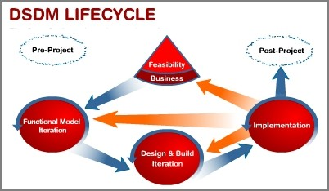

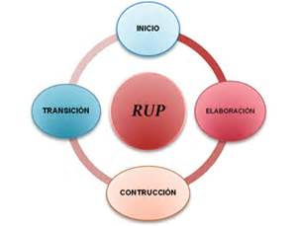
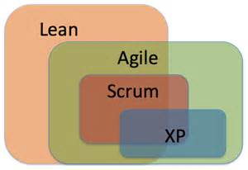
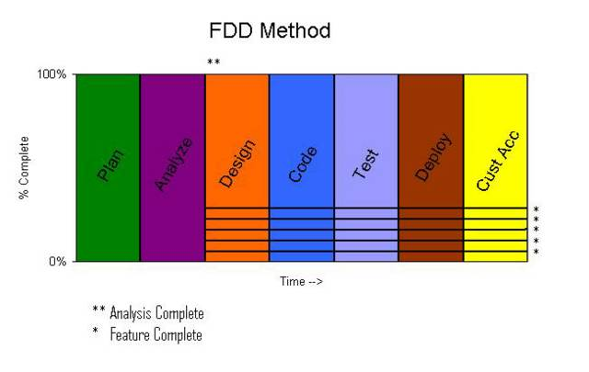
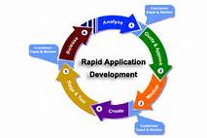

Agile Methodologies (17+)

Slide 16
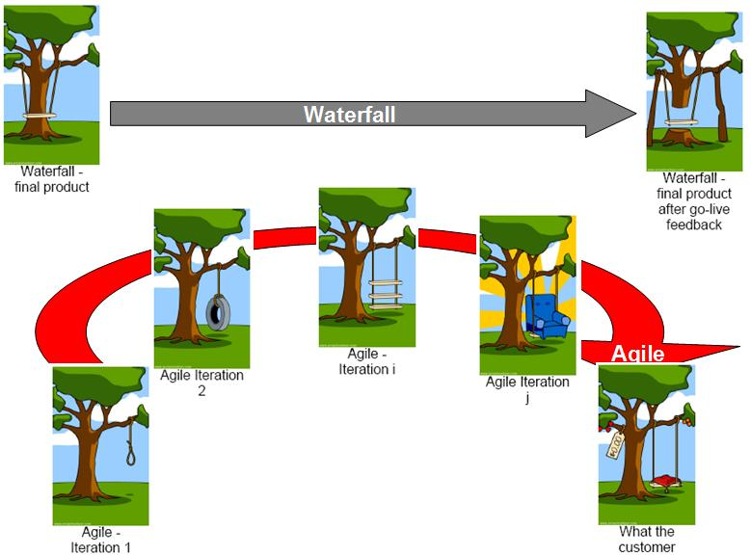
Delivery in Agile

Slide 17
Few Quotes
You lose power when you use and gain when you give it.
Everybody can be great...because anybody can serve.
You have control over your actions and reactions. Controlling other’s action and reaction directly leads to spoiling relations and harmony.
Best competition a team or an organization or a manager can do is with his or her past.
Everybody is unique so enjoy the diversity and do not try to equalize people based on your so called common parameters.

Slide 18

Community Leadership
Intellect, Strength, innocence but purely to listen concerns of other and help others.
Impediment resolver. “VighnaHarta”

Slide 19
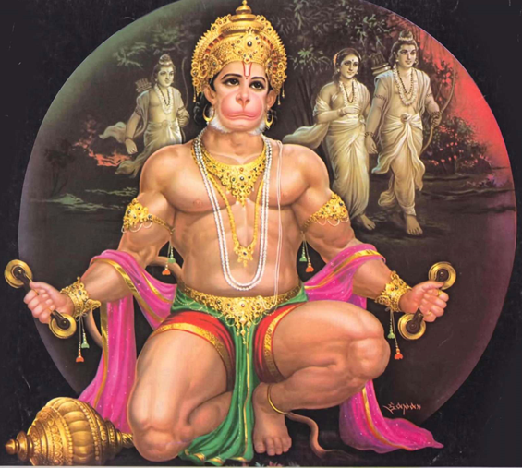
Servant Leadership
Intellect, Strength, Power but purely selflessness dedicated for Dharma.
All power given to me by Lord so I use them to help my Lord.

Slide 20
Agile Methodologies- Scrum
Scrum is widely accepted agile project management methodology among dozen of methodologies.
Scrum is lightweight management framework with broad applicability for managing iterative and incremental projects of all type of projects
Typical iteration (also called “Sprint”) length varies between 2-4 weeks.
Scrum Values
Commitment
Focus
Openness
Respect
Courage

Slide 21
Scrum Roles
Product Owner
Development Team
Scrum Master

Slide 22
A Servant Leader
Discussion

Slide 23


Slide 24
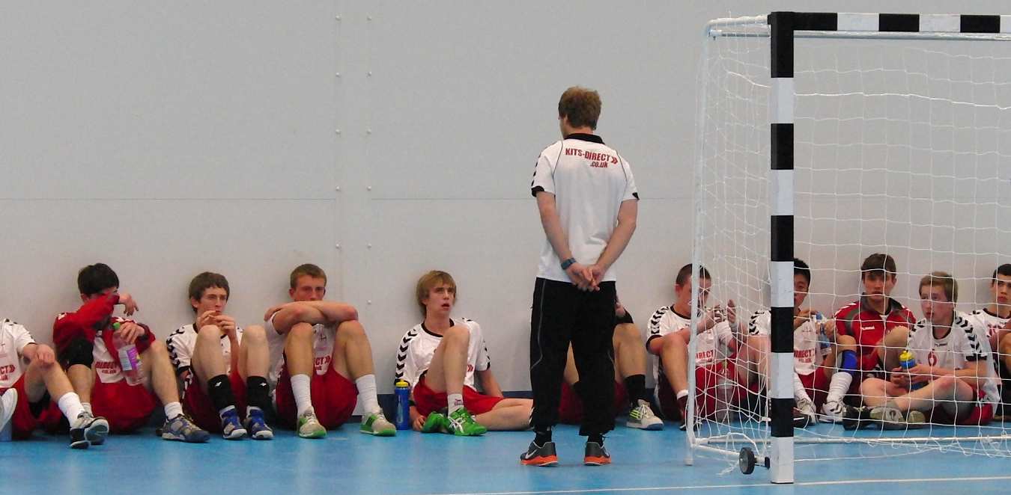

Slide 25
Real Life Challenges of Scrum Master & the solutions
Discussion

Slide 26
Skills, Responsibilities, Authorities of Scrum Master
Good Moderator, Facilitator
A self disciplined person driven by values
Respect in the eyes of the management
Taken seriously by the team, support departments, product owner and customer
Art of making consensus and taking decisions
Trust of the stakeholder that the person will keep project interest always on the top priority and he will not favor any individual unprofessionally
Trustworthy of the management and team
Not boss of the team but Coach, mentor, facilitator

Slide 27
Daily Standup & Scrum Master
Take note of the impediments
Be aware that team is focused on sprint goal
Be aware that team’s moral is high and they are not avoiding daily stand-up
Make sure that the team value daily standup
Resolve or assign impediments to somebody. But ensure they are getting resolved within max 24 hours.
Same impediments should not be repeated into next day’s stand-up
Ensure team is not reporting to you but sharing information with all
Ensure team is using this opportunity to re-plan, reorganize, reassign so that sprint goal can be achieved
Ensure daily standup is heart beat of the system.
Ensure daily standup meeting finish on time and these meetings do not become impediment resolution meeting
Ensure management people do not speak out in this meeting.

Slide 28
Estimation, Release Planning & Scrum Master
Ensure groomed product backlog is in place
Ensure release goal is defined with the help of Product Owner
Decide estimation technique to be used for complexity assessment
Break the release into number of sprints and number of teams.
In case large project where project has release manager help release manager.
Ensure all the sprints of a release are not there for building functionality but one sprint is kept of non-functional requirements, final integration, system testing, security, performance testing and incorporating feedback.

Slide 29
Sprint Planning & Scrum Master
Ensure groomed product backlog is in place
Ensure sprint goal is defined with the help of Product Owner
Ensure team is not over committing neither under committing
Identify the skill gap to complete the work
Ensure team break user stories into engineering task, estimate efforts and self assign the work
Ensure team is not forced to complete X number of user stories. But team based on the their velocity and prioritized product backlog commit the deliverables.
Ensure team remain focused to the sprint goal
Help team and management in understanding that in any sprint team need to spent time on meetings, planning, demo, retrospective, product backlog grooming, technical spike, documentation, refactoring etc.
And there is possibility that some risk may occur and it can consume some time of the sprint.
Therefore keeping above things in mind do not commit based on the 100% utilization and 100% productivity.
Maintain risk register.
If there are too many changes in sprint then recommend Product Owner to cancel the sprint.

Slide 30
Sprint & Scrum Master
Ensure team is focused
Ensure team is functional and they are not thinking in terms of department and individual responsibility but team’s commitment to the Goal.
Ensure product owner is available to explain requirements on need basis
Ensure product owner is validating work using acceptance criteria
Ensure regular builds are happening and testing work is not in spike towards the end of the sprint
Ensure team has development, built, testing, release and deployment best practices and in place and they are being followed
Ensure team is living agile values and principles
Maintain agile health index
Ensure team is updating burndown and burnup chart
Ensure risks are identified and managed meticulously
Maintain risk register & risk burndown chart
Ensure impediments are getting resolved on regular basis

Slide 31
Product Backlog Grooming & Scrum Master
Ensure development team and product owner spends 5-10% of the sprint efforts on product backlog grooming on regular basis.
Do not club the Product backlog grooming, backlog estimation, release planning, sprint planning
If required team is performing technical spike to provide input to the product owner to check the feasibility and make the priority, go/no-go decisions.
Requirements in product backlog are in the form of user stories
Ensure user stories are following INVEST model

Slide 32
Sprint Review & Scrum Master
Ensure Sprint Review (Demo) is conducted by the Product owner to the end customer and not by the developers.
Velocity chart is updated
Customer feedback is documented
Ensure sprint review is a structured meeting
Sprint review do not happen ONLY incase sprint is cancelled.

Slide 33
Sprint Retrospective & Scum Master
Irrespective of the success of a sprint, sprint retrospective must be conducted
Ensure environment is conducive for conductive retrospective and time spent is worth.
Assess the ROTI (return on time invested) of every sprint retrospective
Ensure team members are not critical about individuals but share their experience and ideas to improve the next sprint.
Do not take many ideas for the improvement in a single sprint
Ensure team take this opportunity to improve their practices and processes.
Ensure management is involved at right level to get their attention to make certain decisions (if required).

Slide 34
As a Scrum Master You should
Empathize with the team
Make sure senior people do not make bossy in the project
Ensure people are learning from each other or by doing work
Emphasize sprint goal, release goal, project goal every time
Guide using Agile Values and Principles
Know strength and weakness of individual team member
Know project resource, task dependencies
People driven rather then metrics driven
Value people over Process
Value Delivery over detail long term plan
Value team over ego massage of individual
Protect the team so that they achieve the sprint goal
Ensure definition of doneness is agree for User Story, Sprint and Release.

Slide 35
As a Scrum Master You should
Take calculative risk
Made decisions
Focus on team work rather than heroic work
Pay attention to your SQ rather IQ and EQ.
Inspire team to take risk/fail fast, learn more, deliver more and support them in their tough time
People driven.
Engage with people
Value uniqueness of everybody.
Awareness
Empathy
Persuasion
Give credit to the team
Remove impediments

Slide 36
As a Scrum Master You should NOT
Estimate on behalf of the team
Plan on behalf of the team
Assign work to the team member
Be bossy over the team
Sit far away from the team in some close cubicle. But remain available to the team all the time.
Encourage heroism
Take report from people
Challenge estimation of the team members
Encourage QA vs Dev team
Create competition between people. Rather create great teams.

Slide 37
Driven by Values
Commitment
Selflessness
Respectfulness
Trust
Focus
Transparency

Slide 38
Interpersonal Skills
Communication
Listening
Encouragement
Delegation
Teaching
Coach, Mentor, Friend... Not Boss
Negotiator
Influencer
Lead by High Moral

Slide 39
Revision
Project & Project Management
Modern Project Management Challenges
How to address modern day PM Challenges
What is Agility?
Defined Processes vs Empirical Processes
Agile Value
Agile Principles
Agile Characteristics
Agile Methodologies
Scrum Values
Scrum Roles
A Servant Leader
Skills, Responsibilities, Authorities of Scrum Master
Discuss Real Life Challenges of Scrum Master & the solutions
Daily Standup & Scrum Master
Sprint Planning & Scrum Master
Product Backlog Grooming & Scrum Master
Sprint Review & Scrum Master
Sprint Retrospective & Scum Master
As a Scrum Master You should not

Slide 40

Hari P Thapliyal,
PMP, PMI-ACP, MCITP, Princ2 Practitioner, CSM, MBA, MCA, CIC, PGDFM
PMO Architect & Project Management Evangelist
Profile: http://in.linkedin.com/in/harithapliyal
For content related queries please contact me via
hari.Prasad@vedavit-ps.com
This document is proprietary and confidential. It remains the property of Vedavit Project Solutions at all times. No part of this document may be used, reproduced, or transmitted in any form or by any means electronic, including photocopying and recording, for any purpose without express consent of Vedavit Project Solutions.

